Slide 1


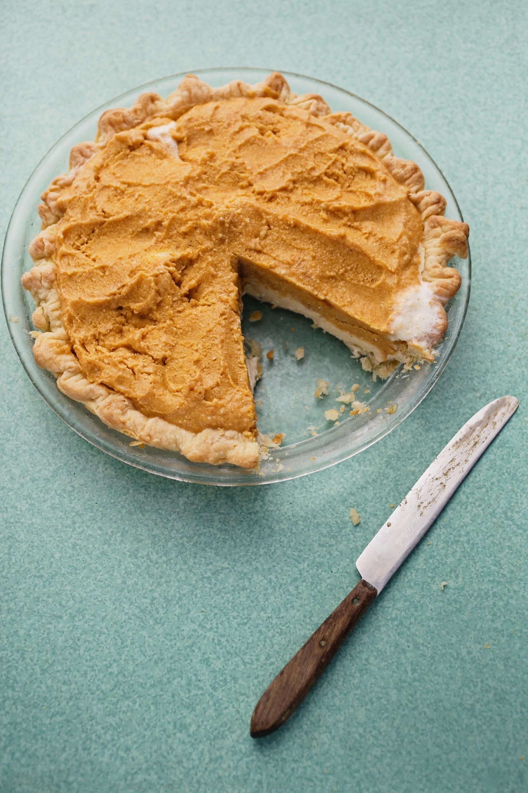
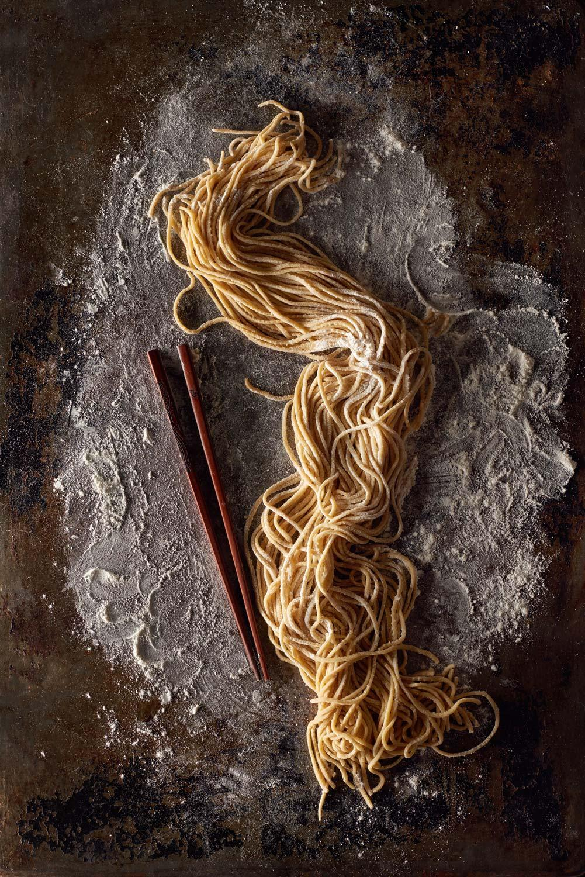
Data Mining
Final Project
Sofya Torosyan
06.06.2020
GOOD FOOD IS THE
FOUNDATION OF
GENUINE
HAPPINESS

Slide 2

The aim of the project is to use Kaggle
“What’s cooking” dataset to categorize cuisines based on ingredients
Dataset consists of
Train data 39774 recipes with cuisines
Test data 9944 recipes
MENU
****************************
Introduction
Data exploration
Data preprocessing
****************************
****************************
Used ML models
.. Logistic regression
.. K-nearest neighbours
.. Naive Bayes Classifier
.. Random Forest
****************************
CONCLUSION

Slide 3
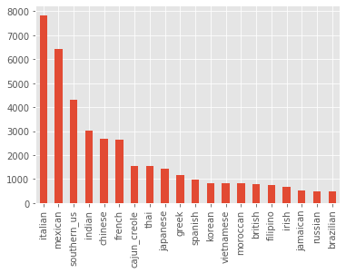
Data exploration showed that we have 20 cuisines, and most frequent recipes are from Italian cuisine, next is mexican, southern_US….

Slide 4
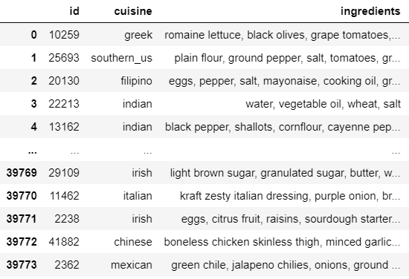
DATA PREPARATION
Modify case
.. Convert all letters to lowercase,
so “PEPPER” and “pepper” will be the same
train will contain 39752 ingredients
Remove non alphabetic symbols
… Ingredients contain symbols/numbers
which are useless
Keep ingredients with >=2 length of name
Convert ingredients from list to string object

Slide 5
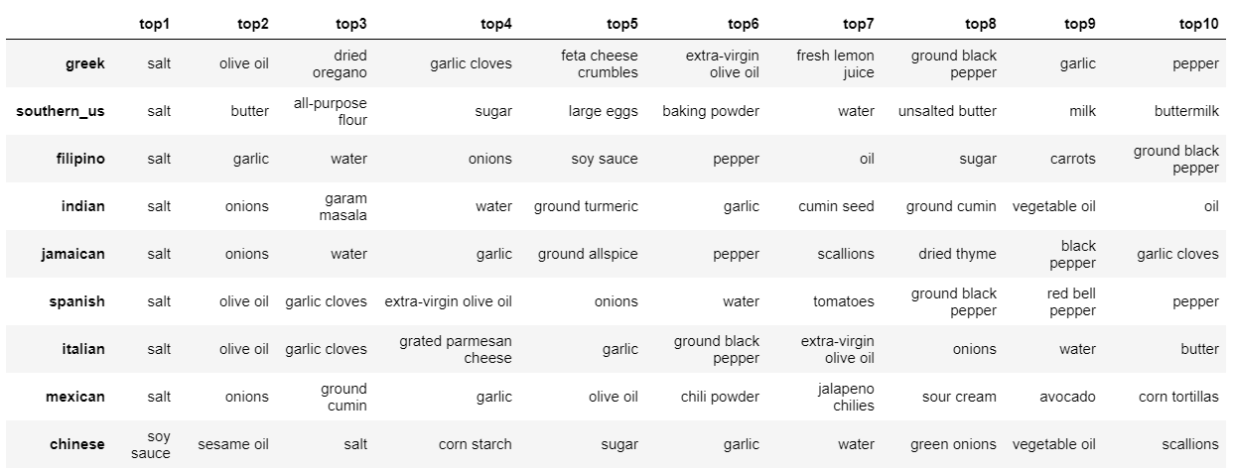
Found top ingredients for each cuisine, it lets us to see which ingredients are common, and which are specific to concrete cuisine. For example salt is most frequent ingredient in recipes in many cuisines.

Slide 6
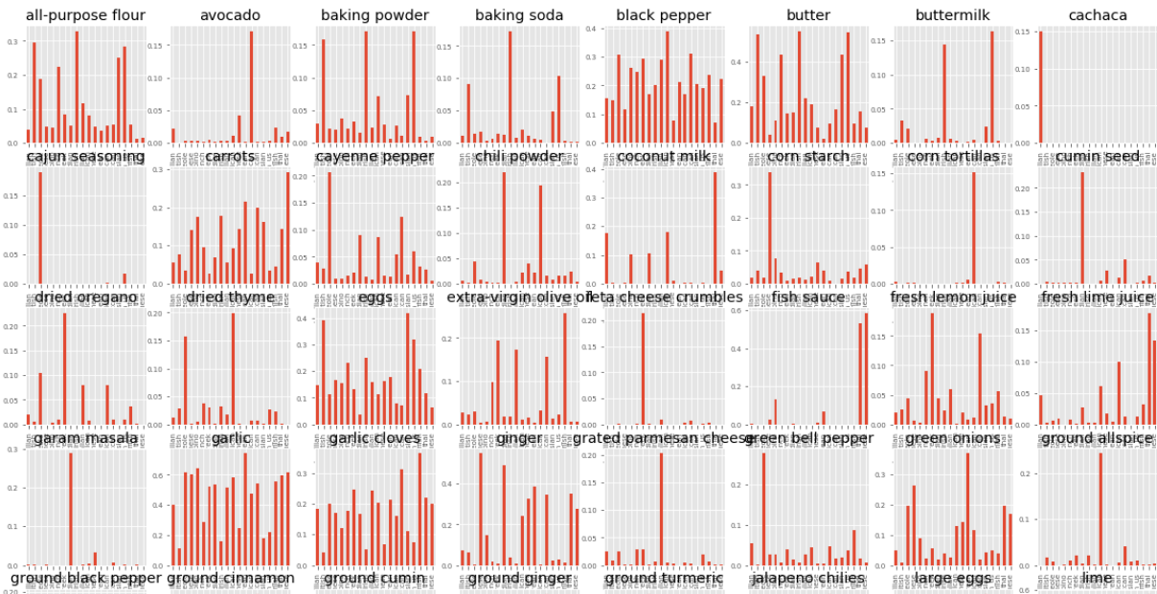

Slide 7
Logistic regression
.. Data encoding using CountVectorizer()
Accuracy ~ 0.7829203873726576 sum(y_test == y_pred) 6225 from 7951
.. K fold cross validation(5)
Accuracy ~[0.78518425 0.78354924 0.79069182 0.78578616 0.78603774]
Mean score: 0.7862498431825751
Decision tree classifier
… Accuracy ~ 0.6286001760784807
K-nearest neighbours
…. Accuracy ~ 0.640045277323607
Naive Bayes Classifier
….Accuracy ~ 0.7219217708464344 sum(predicted == y_test) 5740 from 7951

